Slide 1
CS112 : Introduction to Python Programming
Week 2: lab practice

Slide 2
Practice 1-1: python identifiers
Which of the following is a valid Python identifier?
a) 2_variable
b) variable_2
c) variable-2
d) variable 2

Slide 3
Practice 1-2: python identifiers
Which of the following are invalid identifiers in Python?
a. Total-sum
b. Error
c. Error_count
d. def
e. True

Slide 4
Practice 2-1: integer
Which of the following are integers in Python?
a) 3.14
b) "25"
c) 4
d) "negative”
e) 5.0
f) -3
Hint: Use the type() function to find the data type of an object

Slide 5
Practice 2-2: integer
Find out what does the built-in function abs() do to an integer?
Hint: Use the help() function to get the documentation of modules, functions, classes, keywords, etc. e.g,
help(abs)

Slide 6
Practice 2-3: integer
>>> x = 5
>>> y = 3
>>> x += y
x = ?
>>> x = 10
>>> y = 3
x % y = ?
>>> x = 3
(x + 3**2) // 4 = ?

Slide 7
Practice 3: float
Write a program to
Calculate the area of a circle with diameter of 20 ;
Calculate the area of a square with edge length of 20
Check if the circle area is larger than the square area; Return True or False
Hint: π can be obtained by importing the math module
import math
math.pi

Slide 8
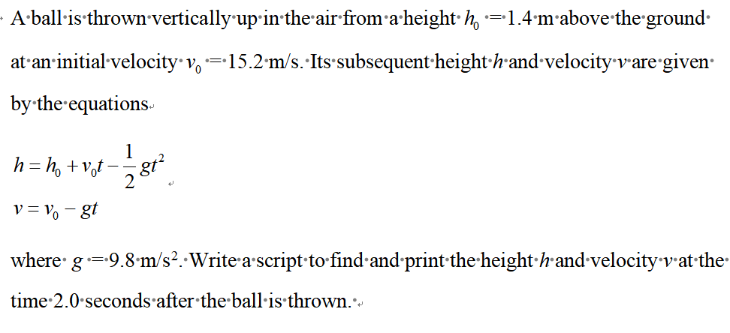
Practice 3-1: float

Slide 9
Practice 4-1: string
>>> a = 'SUSTECH'
>>> a[1]
S
U
C
H
>>> a = 'SUSTECH'
>>> a[-1]
S
U
C
H

Slide 10
Practice 4-2: string
>>> a = 'harsh'
>>> b = a[-3:]
>>> b
rsh
arsh
harsh
rs
>>> a = 'harsh'
>>> b = a[1:len(a)]
>>> b
rsh
arsh
harsh
rs

Slide 11
Practice 4-3: string
>>> a = ‘wo'
>>> b = ‘w’
>>> a + ‘_’ + b*3
wo www
wo_w3
wo_www
wo_3w

Slide 12
Practice 4-4: string
For the following DNA sequence:
ATCGACGTgctaaattggccAGCTTGCAGagccctt
Convert all letters to upper cases and print
Calculate the GC content % (ratio of the nucleotides that are G/g or C/c)
Print the reverse of the sequence
Print the last 10 to last 5 sequence (including the start and end)
Print the sequence every 3 nucleotides

Slide 13
Practice 4-5: string
Split the following file name by ‘_’ (underscore)
file_name = ‘2021_09_14_Ruilin_DAPI_exp1.tif’

Slide 14
Practice 4-6: string
Write a program to count the number of non-space characters in the following sentence.
I think, therefore I am.

Slide 15
Practice 4-7: string
Set two variables, first_name and last_name, then print a string in the following format
My name is last_name first_name.
For example, if your first name is Lei, and your last name is Li, then you should print out
My name is Lei Li.

Slide 16
Practice 4-8: string
Write a string harry_potter_quote that print out the following text with escape sequences.
"Ah, music. A 'magic' beyond all we do here!"
By Albus Dumbledore

